Slide 1

CAPSTONE PROJECT PROPOSAL
Project Group :
Shourish Kothawale – 19202A0047
Shishir Nath – 19202A0054
Shubham Jadhav- 19202A0011
Piyush Nirbhavane – 19202A0006
Project Guide :
Sridevi Taradi
Project Proposal : AY 2021-2022

Slide 2
Domain: Data Science
Topic: Diabetes Detection Web App
Category of the Project:
Beneficial to the society

Slide 3
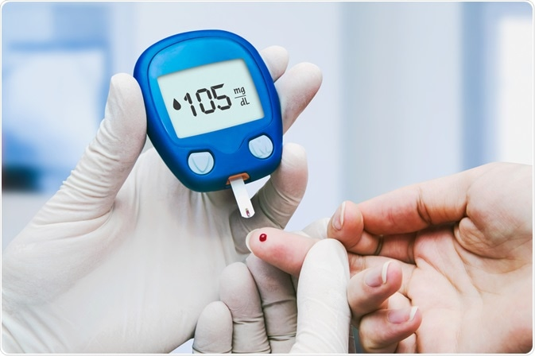

Problem Statement:
To create a web app which detects diabetes, along with the type of diabetes through factors like insulin, blood glucose, age etc. with the help of Data Science and Analysis.

Slide 4
Abstract:
Diabetes is a very common and nasty disease; it occurs due to high blood glucose also known as blood sugar levels. It frequently remains undiagnosed which could lead to complications. Diabetes has many types, and some of them can even turn lethal if it isn’t diagnosed on time.
The disease has been linked with the pancreas, as the pancreas is the main organ that controls blood sugar. Since the pancreas are not able to produce enough insulin, this causes the blood glucose level to rise causing the illness. Sometimes the blood is not able to use the insulin produced efficiently, this increases the chances of getting diabetes. The disease is so common that 1 out of 10 people (2021) suffer from diabetes.
In order to solve this problem, we have decided to create a web app that will take in variables from the user related to diabetes, and will show whether or not they have diabetes (Diabetes Detecting System), and if they have diabetes what level of diabetes do, they have. In addition, we will also provide some information to the user about what they have been diagnosed with and why, and also provide some preventive measures so that the disease doesn’t complicate. We will also add more features like monthly graphs along with alerts, and even a graph tracking their diabetes journey over time.

Slide 5
Current Trends / Technology:
Details of Market Survey, Literature Review, Topics from Hackathon etc:
References:
https://www.diabetes.org/a1c/diagnosis (Different Diabetes Detection Methods)
https://www.healthline.com/health/diabetes/top-iphone-android-apps#fooducate (Different Diabetes detection and tracking apps.)
https://www.frontiersin.org/articles/10.3389/fendo.2019.00135/full
https://www.youtube.com/watch?v=v6VJ2RO66Ag
https://play.google.com/store/apps/details?id=com.mydiabetes&hl=en&gl=US
https://www.sciencedirect.com/science/article/pii/S2352914819300176 (Prediction Model for diabetes)
https://www.sciencedirect.com/science/article/pii/S1877050918308548 (Classification algorithm for diabetes)

Slide 6
Implementation Feasibility
In terms of cost and software/hardware requirement
Technical Paper reviewed, sites reviewed any other source of information
References:
http://tb.test.woza.work/ (Similar app where we got the idea related to TB)
https://www.kaggle.com/mathchi/diabetes-data-set (Data set from national institute of diabetes on Kaggle)
https://data.mendeley.com/datasets/wj9rwkp9c2/1 (Another dataset regarding diabetes)
https://play.google.com/store/apps/details?id=com.mysugr.android.companion&hl=en_IN&gl=US
Cost of the Project:
No additional cost since it is a webapp and no other hardware is required.

Slide 7
Implementation Feasibility
In terms of cost and software/hardware requirement
Hardware and Software required:
Python for implementation.
Python Libraries like pandas, matplotlib, seaborn, sklearn, for manipulating data.
HTML is used to structure the webpage.
CSS for styling the webpage
JavaScript for making the webpage more responsive.
Jupyter Notebook/Spyder for Data Science and Analysis
MySQL for Database
Laptop – Win 11
Text Editor for Client Side Scripting (VS Code)
Pycharm Python IDE
Flask Python for web framework
Algorithm Random forest
Heroku for app deployment on web

